Slide 1

I am a “Smart”watch, Smart Enough to Know the Accuracy of My Own Heart Rate Sensor
Ho-Kyeong Ra¹, Jungmo Ahn², Hee Jung Yoon¹,
Dukyong Yoon², Sang Hyuk Son¹, and JeongGil Ko²
¹DGIST, ²Ajou University
Notes:
Thank you for your introduction.
Hi, My name is Jungmo Ahn from Ajou university.
Today, The name of a paper that I am going to present is "I am a smartwatch, smart enough to know the accuracy of my own heart rate sensor.
This study was conducted with DGIST.

Slide 2
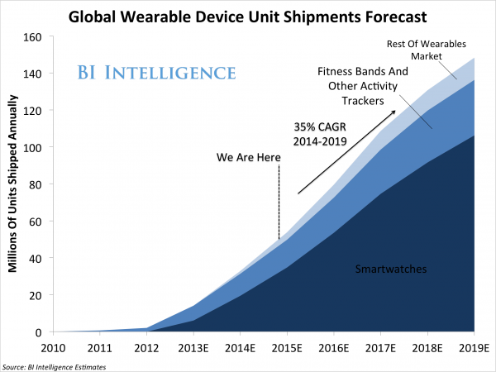
Background : The advent of a new platform, Smartwatch
In addition to smartphones, many users carry additional platforms like a smart-watch.
Smartwatches are capable of capturing new sensing information from the human body.
Motion sensor, Heart rate sensor
*
* BI Intelligence, "THE WEARABLES REPORT: Growth trends, consumer attitudes, and why smartwatches will dominate", Business Insider, 2015. [Online]. Available: http://www.businessinsider.com/the-wearable-computing-market-report-2014-10.
Notes:
First, I want to start by giving you some background information.
(Recently, the number of people wearing a smartwatch is dramatically increasing. )
Business Insider predicted that demand of smartwatches and fitness bands will increase steadily .
Most people who buy smartwatches and fitness bands expect healthcare and fitness management features.
(For this, devices obtain new information from the human body with motion sensors and heart rate sensor.)

Slide 3

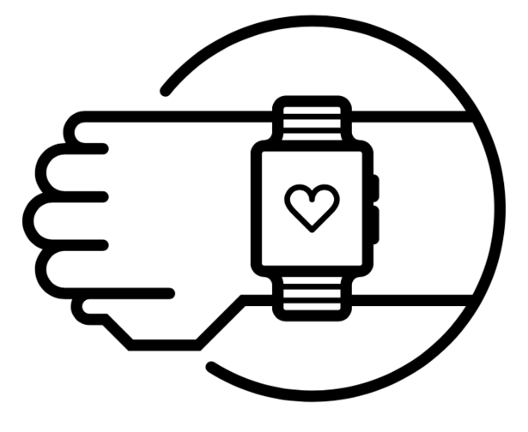
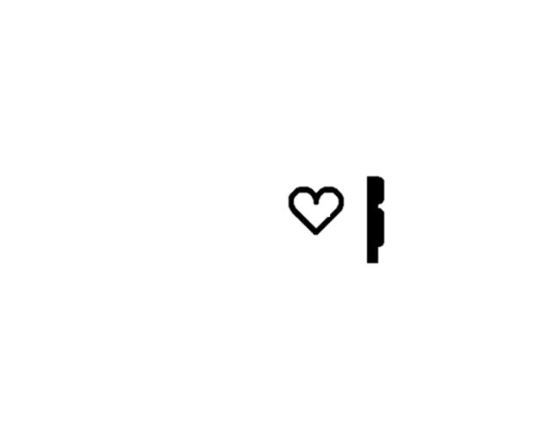

Sensing on Smartphones and Smartwatches
Smartphone and smartwatches share some common sensor modalities
Unlike smartphones, smartwatches are attached to a user's skin.
Sensors on the smart watch open the potential for use in clinical and healthcare applications
Notes:
Let’s look at the sensing modalities supported by a typical smartphone and a smartwatch.)
Actually, built-in sensors are not too different between these devices.
However, Where is your smartphone? It may be in your pocket or bag.
Unlike smartphones, smart watches are attached to a user's skin.
(We can see the potential for use in clinical applications using the characteristics of wearable devices. )
여기까지 빠르게 ㄱㄱ 좀 줄여도될듯.
(클리킹 타임)

Slide 4

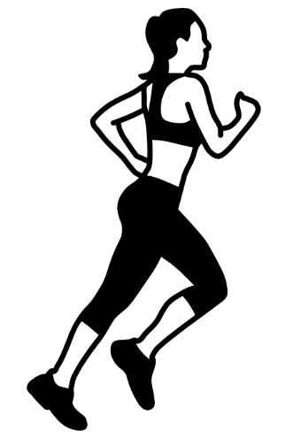

Clinical Application Usage?
Inaccurate readings can negatively impact the healthcare application’s implications on the user’s health status.
Asthma attacks, stroke, heart attack, …
Smartwatch vendors admit that the accuracy of heart rate readings may not be high.
Relax and be still
Motion artifacts
Wearing pattern
Notes:
(However, are these sensors accurate enough for clinical applications?)
Inaccurate readings can negatively impact the healthcare application’s implication on the users health status.
Despite this importance, smartwatch vendors admit that the accuracy of heart rate readings may not be high.
These heartrate sensors on the smartwatches use the PPG readings to infer heartrate.
According to the manual, users should sit still and measure in order to obtain high accuracy.
And motion artifacts or wearing patterns can affect the reading accuracy. < 교수님이 수정하신다고 함
(In this environment, smartwatches are difficult to be used for ubiquitous healthcare application.
too loose wear -> wearing pattern)

Slide 5
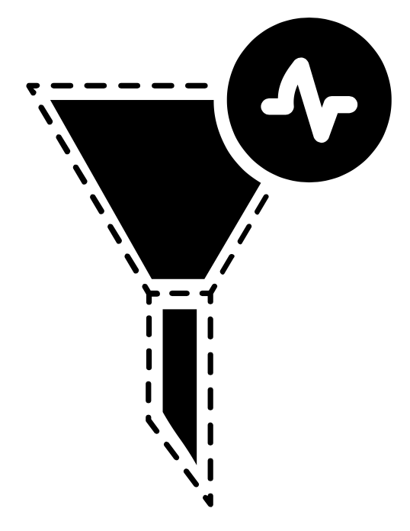
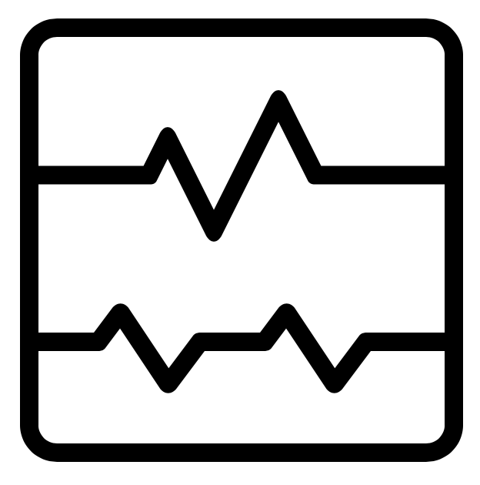
Making the Smartwatch Sensors Reliable!
Application Side
High
Accuracy
Use
Low
Accuracy
Discard
If smartwatches can predict the accuracy of the heart rate sensor itself, applications can selectively use the measurement according to the accuracy.
Notes:
(So, What can we do to solve this problem?)
We suggest a filter to determine accuracy of measurement.
If smartwatches can calculate the accuracy of the heart rate sensor itself,
the application can selectively use the 'measurement result' according to the accuracy.
You can easily think that you can correct wrong measurements and it is plausible to detect such wrong sensor readings.
However, It is not easy to fix already broken measurements to normal values because there can be many external factors.
Instead, we can try to apply a filter to eliminate wrong measurements as a process prior to calibrating wrong measurements.
This is what we aim to do in this work.
설명이 좀 더
수정을 하지 왜 버리냐? – 이게 전단계다.
미리 예상질문을 약간 답변
잘못된 측정값을 수정할 수 있다고 쉽게 생각할 수 있습니다.
하이어큐러시 - > 애플리케이션 냄새 prior 발음

Slide 6
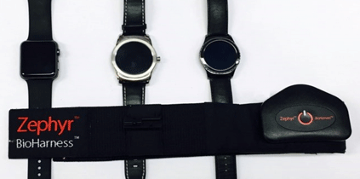
Validation on accelerometer-based approach
a)
b)
c)
d)
We use three popular smartwatches to validate accelerometer-based approach.
a) Apple watch b) LG Urbane c) Samsung Gear S2
These smartwatches are compared with ground-truth data from
d) Zephyr BioHarness is FDA approved ECG based chest-strap form-factor and able to read heart rate very accurately even when the user walks.
Notes:
(Some previous work show that they can calibrate or identify motion artifacts using the accelerometer readings.
Usually these algorithms are complex and the computation takes place off-line.
Nevertheless, in order to validate accelerometer-based approaches proposed in previous works, we used Apple Watch, LG Urbane and Samsung Gear s2 for data collection컬렉션. )
As a ground truth, we use zephyr’s Bioharness.
This device is FDA approved ECG based chest-strap form-factor and able to read heart rate very accurately even when the user walks.
제퍼 ( f라고 생각)
이거 전에 어떤 문제를 해결할 건지를 .. – 가속도계가 별로 안좋다
*목적*
기존의 연구 방식처럼 가속도계를 이용해서 측정이 잘 되는지 알아보기 위해

Slide 7
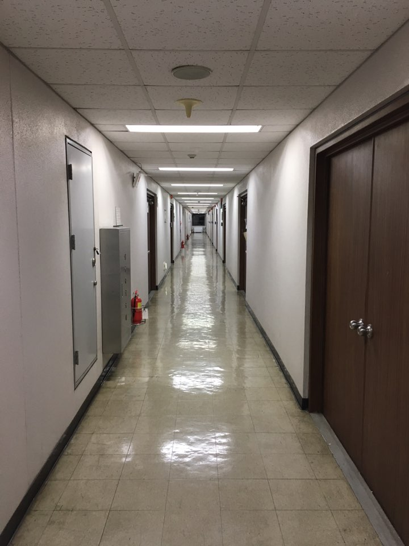
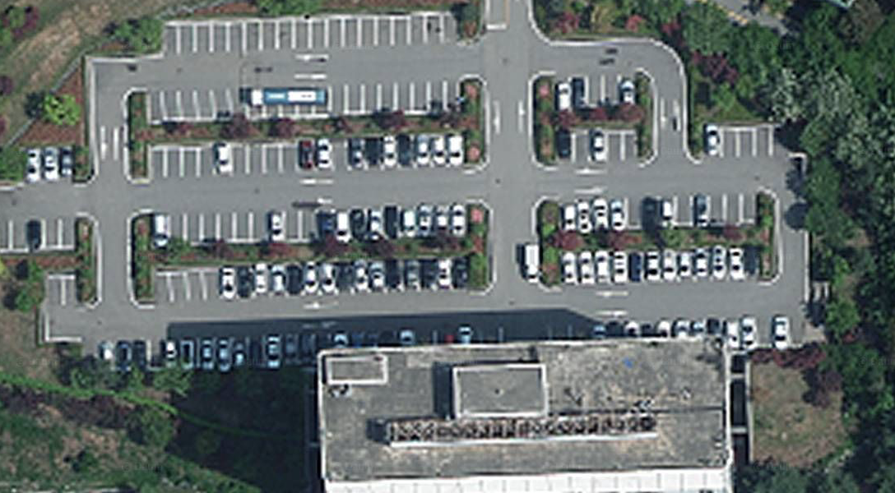
Preliminary Study : Experimental setup
We ask 4 volunteers (average age of 24; 1 female, 3 male) to naturally walk in a hallway and an open field under fluorescent and day-light conditions while wearing a smartwatch and BioHarness.
Notes:
We ask 4 volunteers to naturally walk in a hallway and an open field under fluorescent플루어레슨트 and day-light conditions while wearing a smartwatch and BioHarness.

Slide 8
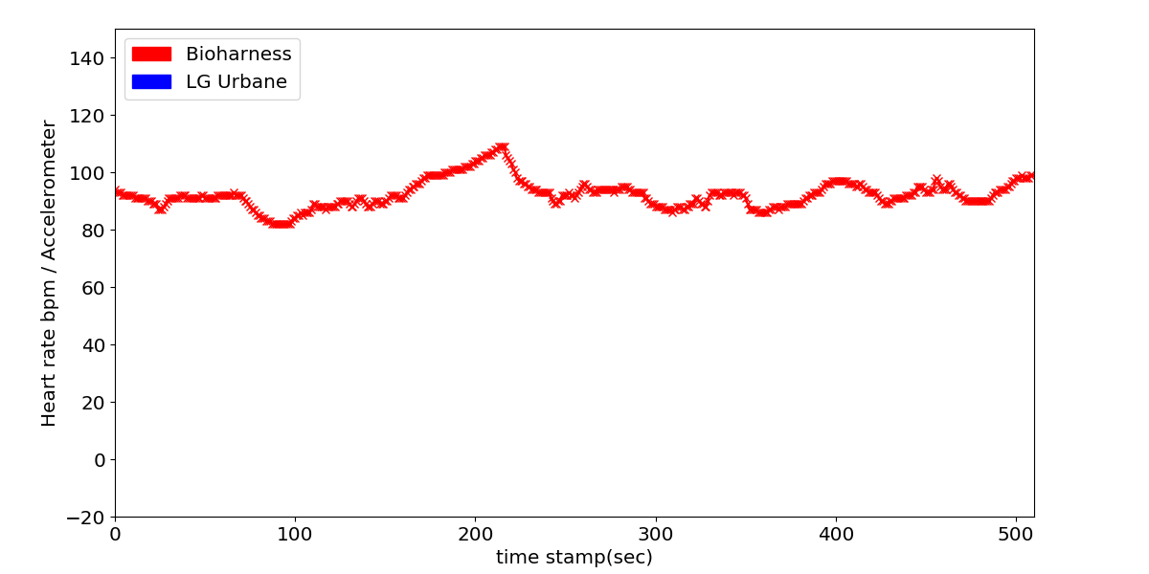
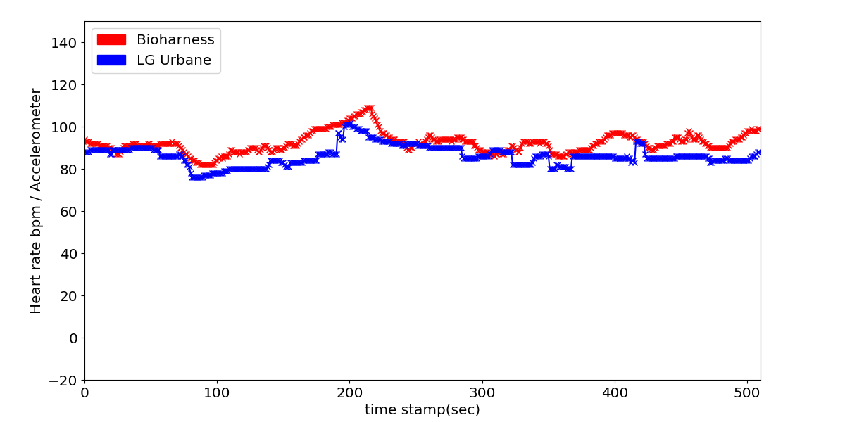
Smartwatch Worn Tightly – Less Difference
Mean Error
3bpm
Watch worn tightly – LG Urbane
Notes:
In order to know the difference in accuracy caused by the wearing condition of users, we ask users to wear the smartwatch tightly or loosely and walk.
Look at following graphs.
The Y-axis is the heart rate reading in beats per minute and the X-axis is the timestamp in seconds.
The Red line represents readings from the Bioharness as the ground-truth, and the blue line represents readings from the Smartwatch.
First, when the user wears the smartwatch tightly, there are not much difference between the smartwatches and the bioharness readings.
The mean error is approximately 3 bpm for all kinds of smartwatches.

Slide 9
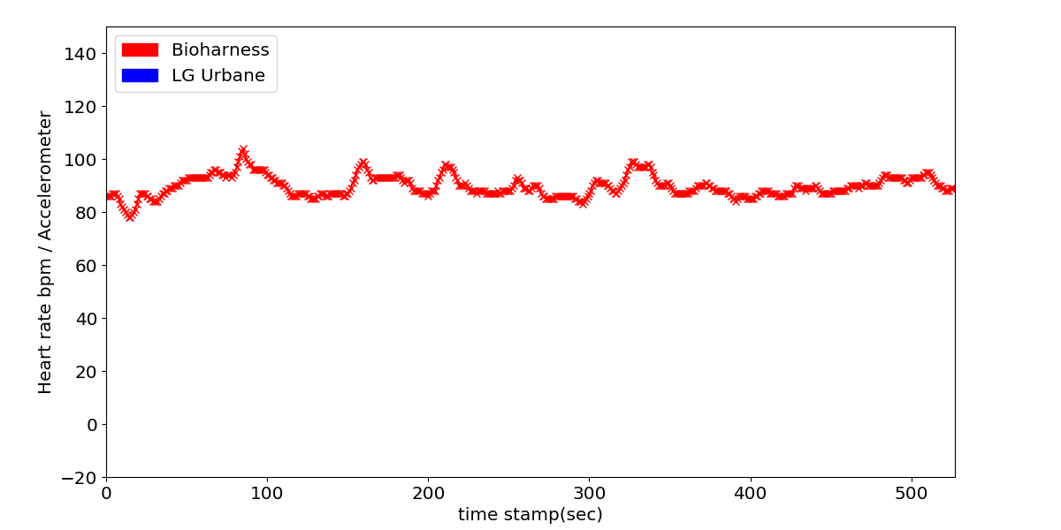
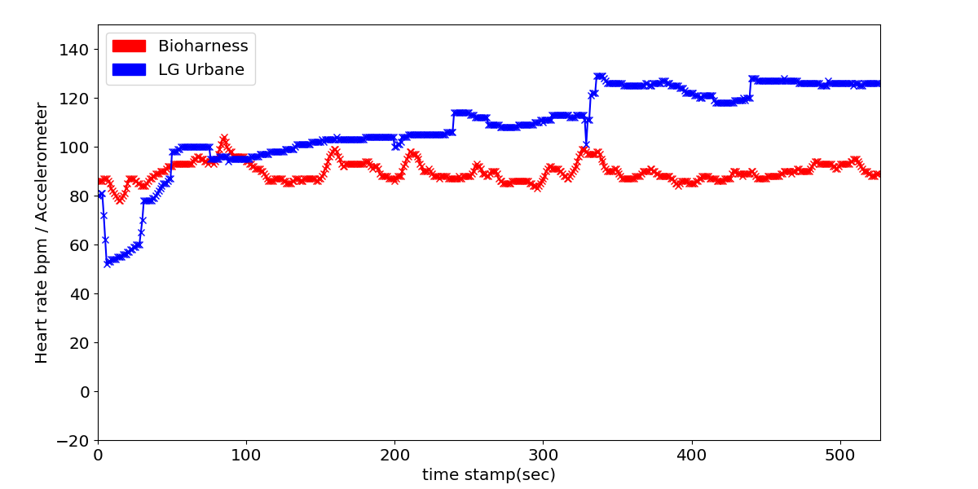
Smartwatch Worn Loosely – High Difference
Mean Error
18bpm
Watch worn loosely – LG Urbane
Notes:
Second, the accuracy of the heart rate sensor was not high when the devices are loosely worn.
This shows that the wearing conditions can have crucial impact on the accuracy of the heart rate sensor.
The error is about 18bpm on LG Urbane smartwatch.
In case of other smartwatches, Apple watch has 9bpm error and Samsung Gear S2 has 29 bpm error.
그래프를 보여주고 그냥 내 설명을함. 그래프랑 매칭이 힘듦. 시간을 충분히 사용
그래프의 설명.. 각 설명과 맞는 그래프만 띄워주자.

Slide 10
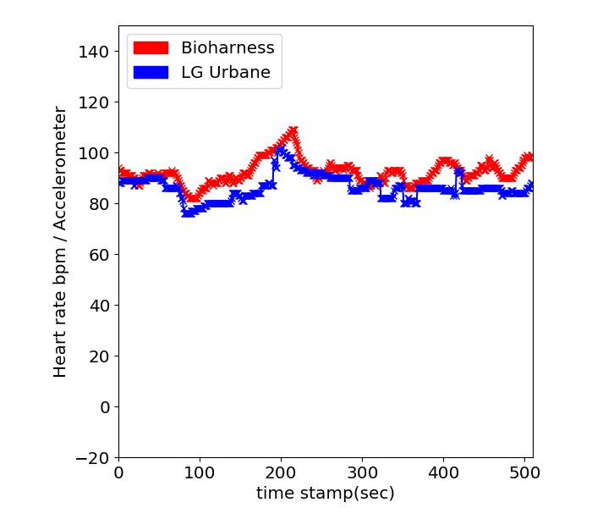
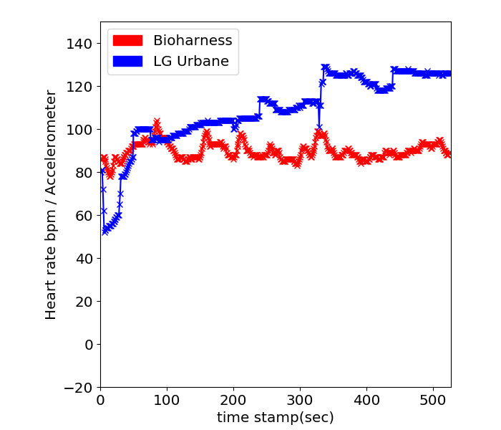
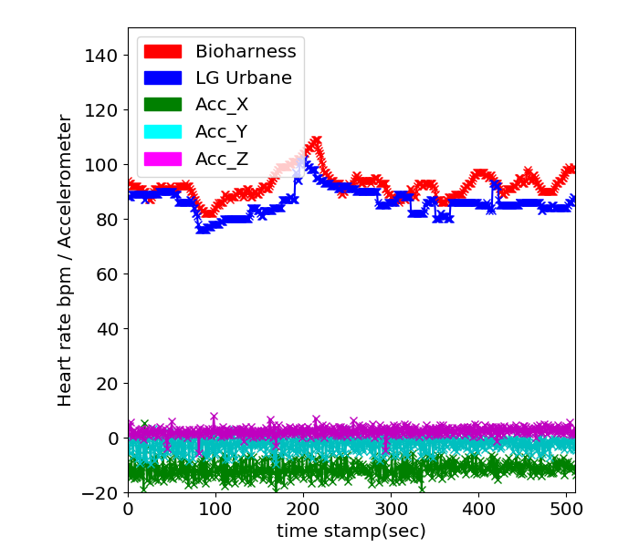
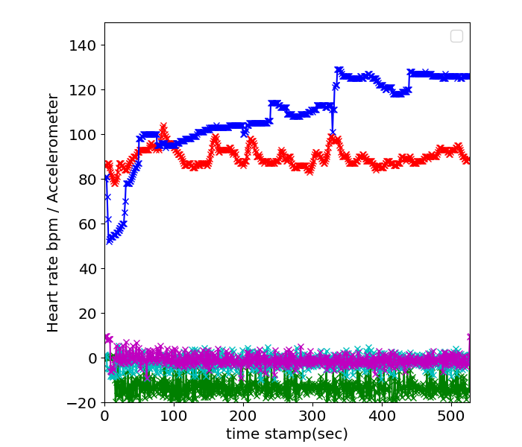
Accelerometer for Detecting Accuracy?
Mean Cross Correlation Coefficient : 0.77
Watch worn tightly– LG Urbane
Watch worn loosely– LG Urbane
Notes:
Third, each accelerometer signals are similar both wearing condition.
The average cross correlation coefficient between the two data is 0.77, indicating that the two signals are similar.
In conclusion, motion sensor may not be enough to measure accuracy of heart rate sensor, or may need complex signal process techniques.
0.77 represents a high correlation and this means that the signals are similar.
May not be enough to detect the accuracy of heart rate using a motion sensor.
0.77이 정말 높은거?? 대답준비해봐
It is numerically high. As I mentioned, there were accelerometer-based algorithm to classify accuracy of readings . But we need an algorithm to run on the smartwatch. So I decided to use a light intensity rather than a complex accelerometer.

Slide 11
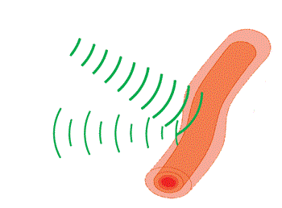
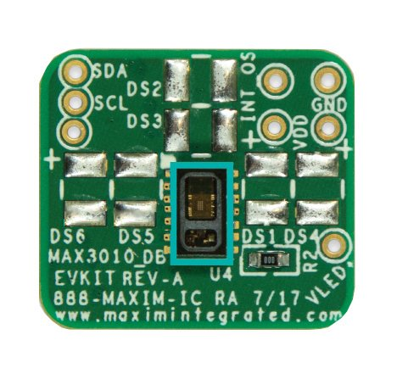

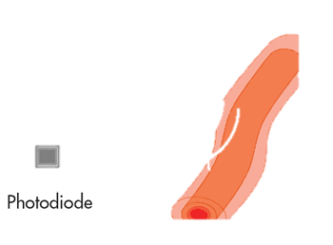
Photoplethysmogram (PPG)
Photodiode
GREEN LED
PPG Sensor
Uses green LED light emissions and a photodiode capturing reflected light levels from the skin.
Detects heartrate by measuring the differences in light absorption from the skin.
Notes:
Here is a brief overview of the principles of smartwatch's heart rate sensor PPG.
It emits green light to the skin at 1 KHz.
The reflected level of light is detected at the photodiode and is used to measure the amount of blood flowing through(뚜루) the veins.
This value is used to estimate the heartrate.
We decided to look in deeper into its characteristics to find a potential pointer towards identifying wrong heartrate readings.
원래 알고 있었던거처럼 ㅋㅋ; 10과 11을 바꾸면 좋을듯

Slide 12
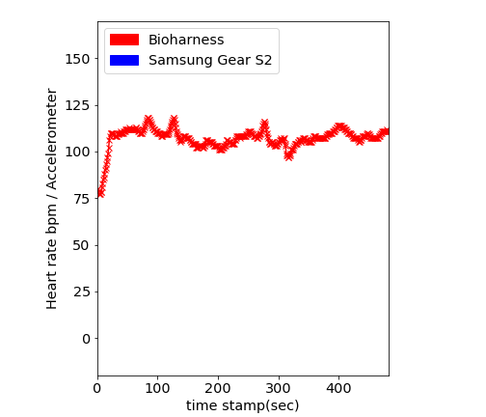
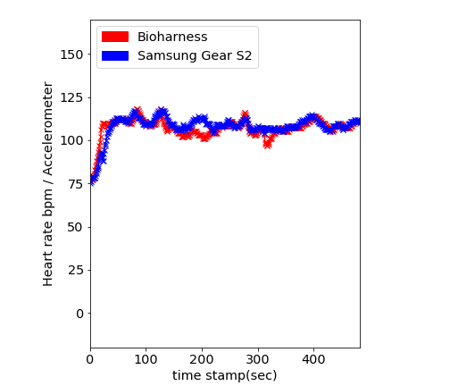
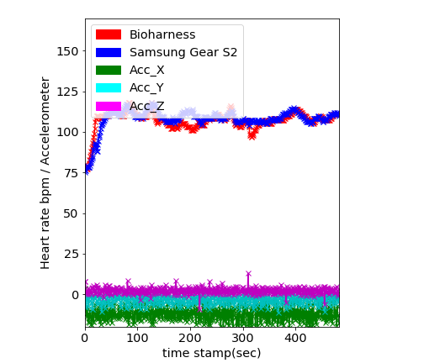
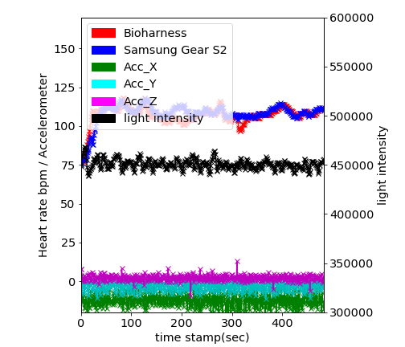
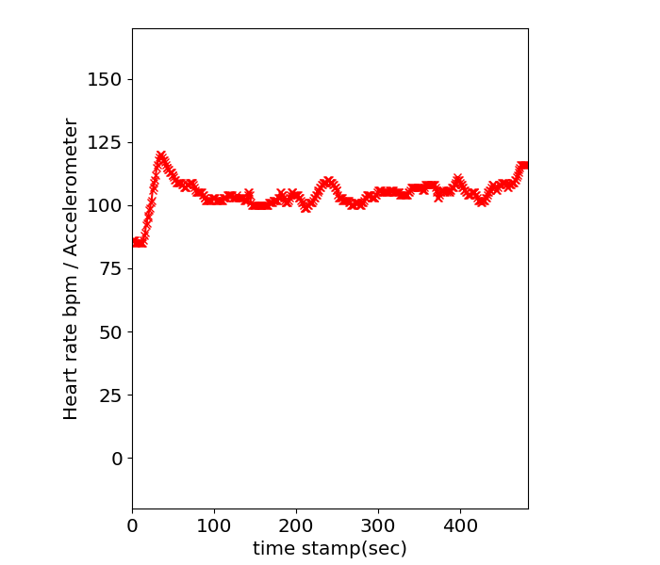
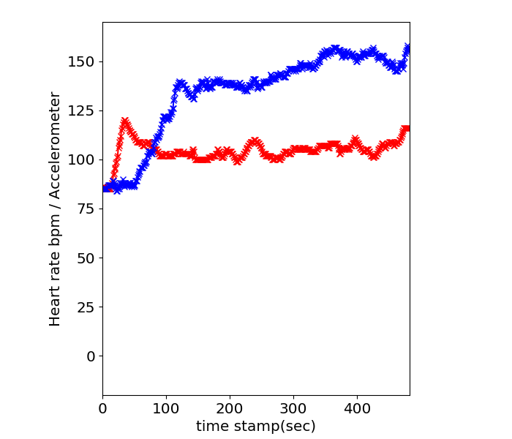
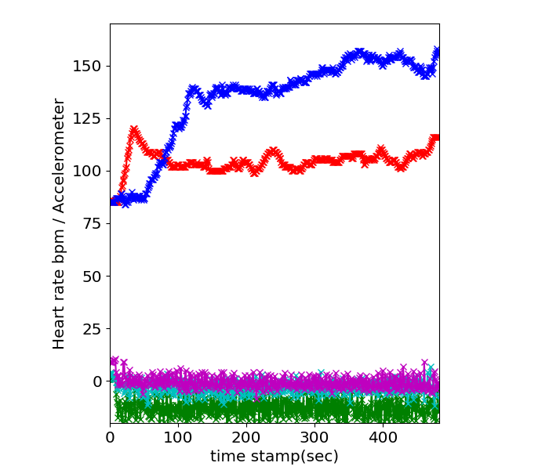
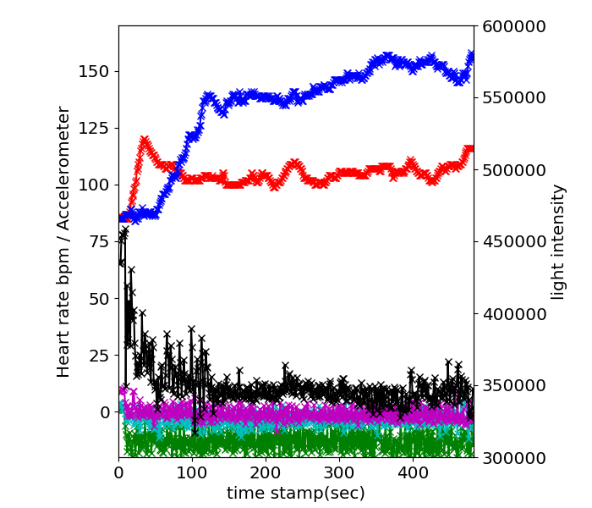
Light intensity of PPG Sensor
Samsung Gear S2 worn tightly
Samsung Gear S2 worn loosely
Notes:
These graphs are for the Samsung Gear S2.
Like previous LG Urbane watch’s graph, when the user wears smartwatch tightly, error is not high.
In the opposite case loosely worn, on the right, the heart rate readings from smartwatch diverge far from the ground-truth as expected.
The accelerometer pattern is similar both worn conditions.
Especially, Samsung gear s2 using Tizen OS provides light intensity of PPG sensor.
We plot this light intensity as black line.
The important point here that we need to understand is that each accelerometer signals are similar both situation but light intensity signals are different.
When the smartwatch’s heart rate readings diverge from the BioHarness, the light intensity values tend to show higher variations.
So we thought that PPG sensor's light intensity value may be a hint in classifying accurate and inaccurate HR readings.
라이트 인텐시티가 불안정하기 시작하면 값이 안정화 될 때까지
Cumulative results of light intensity readings

Slide 13
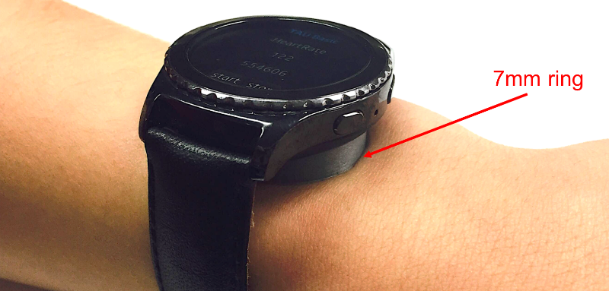
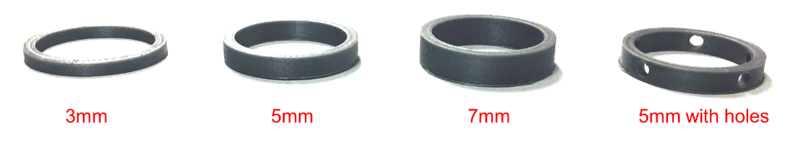
What factors impact quality of heart rate readings?
Absolute value of PPG light intensity vs. Variance of light intensity
We printed three rings of different heights in order to see what characteristic of light intensity impacts quality of measuring heart rate.
Notes:
(To validate our observations, we wanted to know how light intensity impacts the quality of heart rate measurements.)
As we saw in the previous slide, with loose wearing conditions, light intensity values tend to show higher variation.
However, a different angle of observing PPG light intensity is looking at the changes in absolute values as well.
To figure out what characteristic of light intensity affects the heart rate accuracy, We 3D printed three rings of different heights and one ring with holes.
The three rings affect the absolute value of the light intensity by changing the distance between the ppg sensor and the skin.
When using these rings, we noticed that the absolute values of light intensity decreased with increasing height.
The ring with holes generates a case where external light passes between the ppg sensor and the skin. We use this ring to intentionally(인텐셔널리) make variations to light intensity readings.
자랑하기

Slide 14
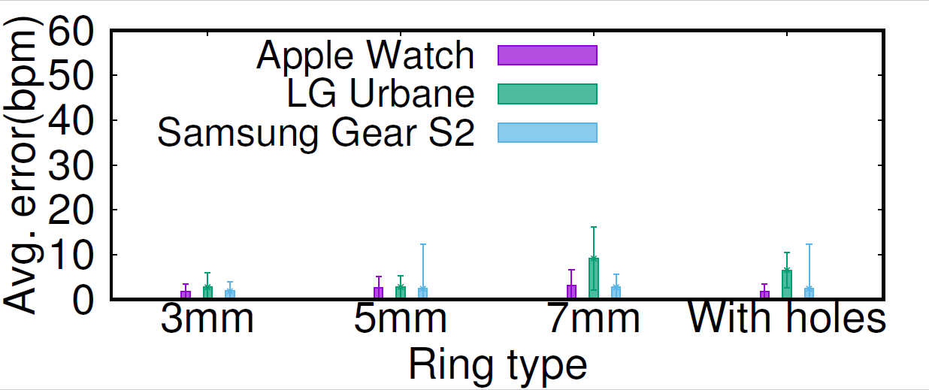
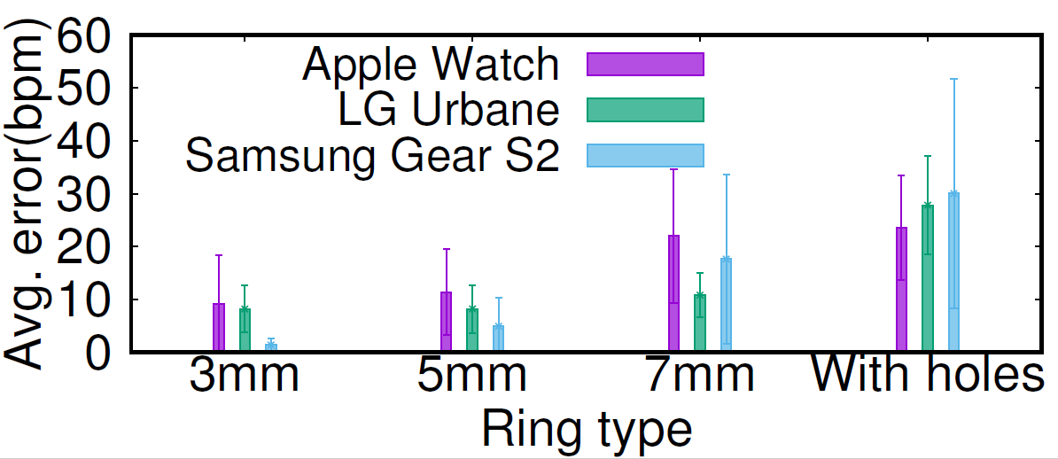
What factors impact quality of heart rate samples?
(a) Average heart rate error for standing still
(b) Average heart rate error for naturally walking
We run two sets of experiments with four rings with and without holes
(a) Standing still, (b) Naturally walking
Figure (a), errors for all cases are less than 10bpm when users stand still.
Figure (b), errors for all cases are higher than case of (a) when users walk.
Especially, case of ’With holes’, difference of errors between (a) and (b) are highest because of varying patterns of external light.
14
Notes:
(We run two sets of experiments with three rings without holes and one ring with holes. )
Figure (a) on the left, shows that the heart rate sensor error is less than 10 bpm in all cases when users stand still.
However, Figure (b) on the right, shows that errors for all cases when users walk are higher than case of Figure (a).
Especially, case of ’With holes’, difference of errors between figure A and figure B is highest because of varying patterns of external light.

Slide 15
What factors do impact quality of measuring heart rate?
Photodiode
GREEN LED
PPG Sensor
If the PPG Sensor vibrates by motion artifacts, the photodiode cannot read the reflected light from the skin properly
This causes irregular light intensity readings at the photodiode.
Notes:
In conclusion, if the PPG sensor is moved by motion artifacts, external light patterns interfere heart rate readings as seen in the previous situation with the ring with holes.
this complicates the photodiode from reading the light, reflected from the skin.
Naturally, this drops the accuracy of the heart rate readings.

Slide 16
Next steps
Application Side
High
Accuracy
Use
Low
Accuracy
Discard
Is a simple threshold-based scheme feasible? Not really…
Changes between two consecutive readings are too rigorous
Users have different watch wearing patterns.
Notes:
With these findings in mind, to design a system to detect heart rate reading accuracy, the next step is to design a filter.
According to preliminary studies, by analyzing the PPG sensor light intensity variance, we can potentially design a filter for classifying the accuracy of the smartwatch’s heart rate sensor readings.
Intuitively, a threshold-based scheme for PPG light intensity variance may seem plausible and extremely lightweight.
However, the changes between two consecutive readings are too rigorous that the stability of the decision-making may suffer without the knowledge of long-term readings.
Moreover, each user has their own wearing condition so that predefined threshold model may not be fit.
Instead of threshold based design, we designed a filter using variances of the light intensity value of the PPG sensor in time window.

Slide 17
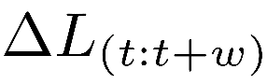
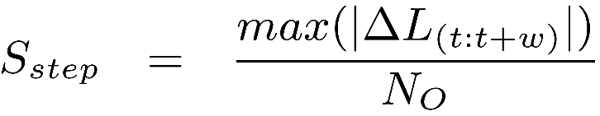
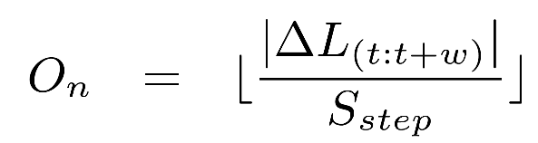
Filter design
Set of differences among consecutive PPG light intensity readings:
Identify light intensity step size between observations:
Compute observation for each time window:
Start
Good
Bad
Observation
1
Observation
2
Observation
3
Observation
11
Notes:
The design of our filter employs the Viterbi algorithm.
the Viterbi algorithm is used for finding the most likely sequence of hidden states. – sensing data quality
We define 델타엘 as the set of differences among consecutive PPG light intensity readings in time window t to t+w.
Then we identify light intensity step size by max value in time window divided by N0.
N0 is the number of observations.
Then we compute observation for each time window.
The details of the filter design can be found in our paper.
We applied our datasets to this filter.
* 필터설명 추가.

Slide 18
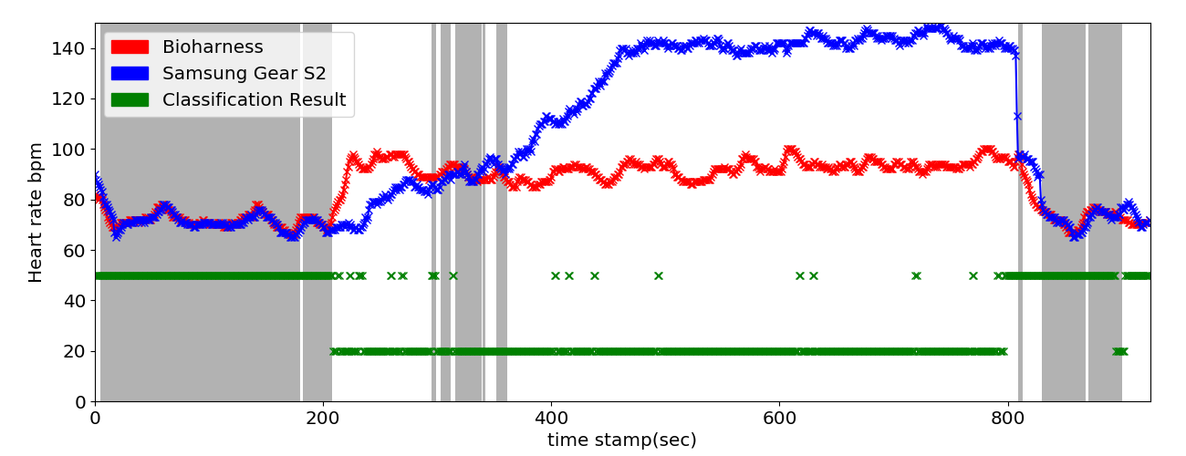
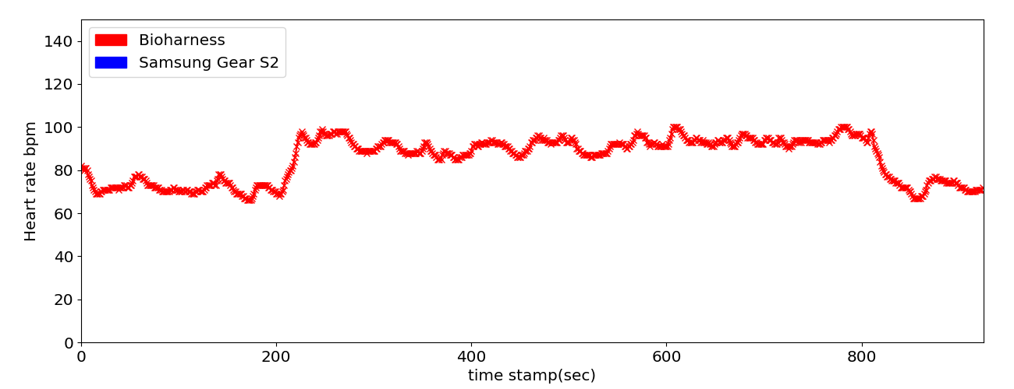
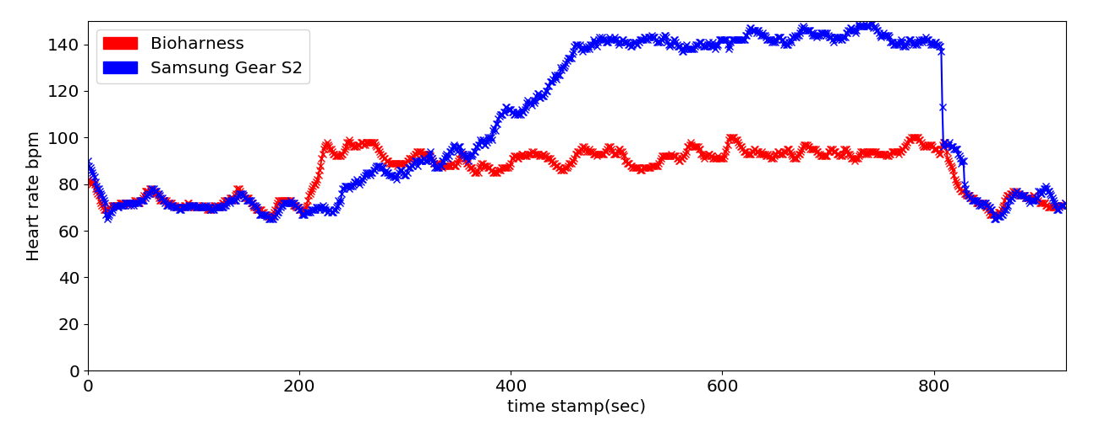
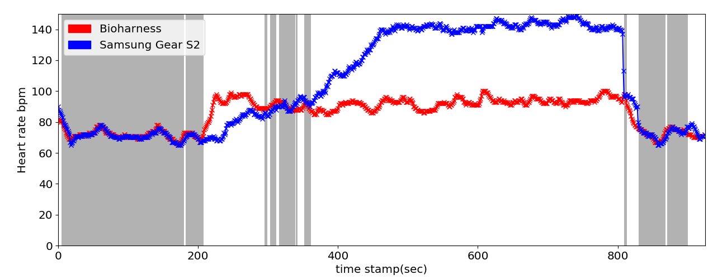
Evaluation : Classification Result
Not Moving
Actively Moving
Relax
Classified as ”accurate”
Classified as ”inaccurate”
classification results of the proposed filter
The gray background represents the area in which the ground- truth and the smartwatch readings differ by less than 3 bpm.
The green dots present our filter’s classification result.
Notes:
(This graphs show a result after applying our filter to our dataset.)
This plots a time-series of the samples collected from the Samsung Gear S2 and the BioHarness with loosely worn.
This sample is one of the four samples we collected from our participants.
In this experiment, the user started with 3 minutes of “not moving” followed by 10 minutes of actively moving.
As expected, when the user starts walk, readings diverge.
The gray background represent the smartwatch is reading the accurate values, with less than 3 bpm difference from the GT.
The green dots above indicate that our filter has classified a measurement as accurate.
And the dots below indicate that our filter has classified a measurement as inaccurate. (above와 below 를 찝어주자) 말하고자 하는걸 간결하게 찝어줘야함
(Our filter classifies samples well but you can see that there are some wrong classifications.)
실험세팅, 그래프 설명(다시) 일단 하나 날리고 애니메이션 (그래프 하나에 메세지 하나둘)

Slide 19
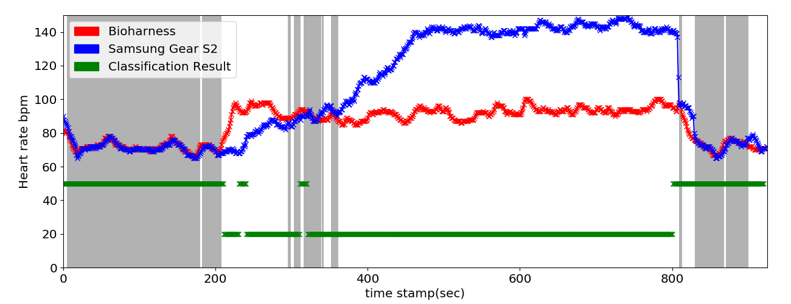
Evaluation : Classification Result
Classified as ”accurate”
Classified as ”inaccurate”
classification results of the filter with moving average
We focus that the heart rate accuracy does not change instantaneously.
We use moving average of the values as observation inputs.
Conservatively declare “accurate” samples when recent measurements were “inaccurate”.
Notes:
(To resolve such drawback, we focus on the fact that the heart rate does not change
instantaneously. 인스턴태니어슬리)
Specifically, instead of using instantaneous measurements, we use the moving average of values as observation inputs.
As a result, the modified filter conservatively컨서얼버티블리 declares “accurate” samples when recent measurements were “inaccurate”.
As you see, not all dots are high in the gray area.
Note that in a clinical situations our filter should be highly reliable. However if not perfect, our filter should minimize false negatives, which classifies inaccurate samples as accurate. (FN이 뭔지 한번 이야기-Classifying ”inaccurate” samples as “accurate”)

Slide 20
Evaluation
100%
95%
90%
<3bpm
85%
80%
<5bpm
<7bpm
60%
40%
20%
5%
10%
15%
True-Negative
Classifying ”inaccurate” samples as “inaccurate”
False-Negative
Classifying ”inaccurate” samples as “accurate”
False-Negative is especially important for clinical devices.
Our filter shows good performance in identifying inaccurate measurements.
Notes:
(Take a look at our True-Negative and False-Negative classification graph.)
In the 3 bpm case, if the value reported by the smartwatch has less than 3 bpm difference with the ground truth, we declare that sample as accurate. If the difference is more than 3 bpm, the measurement is considered inaccurate.
The true-negative case is when our filter correctly classifies inaccurate samples as inaccurate and the false-negative case is when our filter wrongly classifies inaccurate samples as accurate.
Note once again, that our filter should minimize false-negatives given that we want to suppress inaccurate samples from being used as inputs for clinical applications.
In the 3 bpm case, the TN showed 95% and FN was low at 5%.
In other words, our filter shows good performance in properly identifying inaccurate measurements from the smartwatch.
If we ease the bounds for determining accurate measurements, the TN decreases while FN increases.
퍼센트 맞추기.
명시적으로 표현하기.
(퇴장)
질문고민해야함… 앞으로 어떻게 될거같냐? 문제가 없을거같냐? 어차피 FDA승인 받지 않은거아니야?
TP랑 FP는 어떄? - TP는 80 FP 20
True-Negative > 90% with the 3 bpm threshold
False-Negative < 8% with the 3 bpm threshold
* 센시스 질문 – 이거 했을때 버리는 데이터가 너무 많지 않나? (아직 보정을 해주는 단계는 아니라서 너의 말이 맞다. 하지만 우리의 필터를 통해서 나중에 캘리브레이션 시에 선별적으로 할 수 잇다. (we can selectively calibrate sensor readings)

Slide 21
Summary
Evaluated the heart rate measurement capability of the current smartwatches in various wearing conditions.
Identify that accelerometer based motion estimations may not be enough to predict inaccurate heart rate readings.
Design and implement a filter to detect which data samples differ from the ground-truth.
Notes:
(In summary,)
We evaluated the heart rate measurement capability of the current smartwatches in various wearing conditions.
Based on this, we identify that accelerometer-based motion estimations may not be enough to predict inaccurate heart rate measurements.
So we designed and implemented a filter to detect which data samples differ from the ground truth.

Slide 22


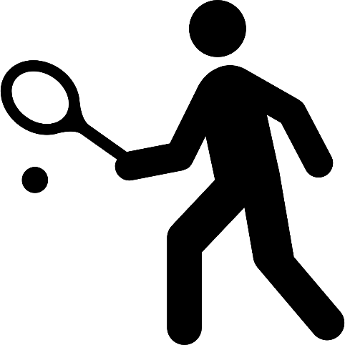
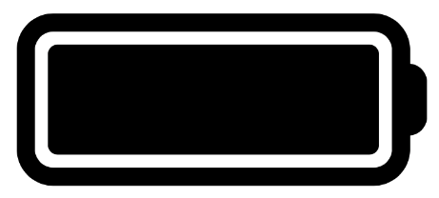
Future works
Combining Accelerometer Information
Modularization for Developers
Highly active exercise
Low Energy Consumption
Notes:
(Our filters can be further improved.)
Our filter will get more accurate results by combining an accelerometer information. (연산량의 차이로 기존연구는 밖으로 빼서 했다.)
We will also modularize our filter so that developers can use it to develop clinical applications.
In addition, though this study measured normal walking condition, we can be also applied to highly active sports such as tennis.
Finally, battery efficiency is important because clinical devices must continually check your health.
These are just a subset of the future work we plan to do and I will be happy to receive feedback on how you think our system can be applicable to real world clinical applications.
We didn’t check energy consumption but I think that our filter may not use much energy. Because there is a defined model, computing accuracy is not complex.

Slide 23
THANK YOU
Jungmo Ahn
ajm100@ajou.ac.kr
Notes:
Thank you… and I will be happy to take any questions.
Sorry, I cant understand
Are there any questions?
질문 : That's a good question // 지적 : That's a good point 재확인 If I understand you correctly, you want to know...
다시좀.. Sorry, I didn't catch the question.
이미 말했는데,, As I said earlier....
I would be glad to discuss that with you personally after the presentation.
That’s good point. Actually it is not on my experiments. I will remain your comment on our future works.
그럼 꽉 차면 되는거야? –. As I mentioned earlier, users have their own wear patterns. We didn’t target this work to use all readings but use selectively accurate values among readings.
라이트 인텐시트 변화가 적은거같은 부분이 가장 크게 에러가 나네?
The heart rate measurement value is determined based on the read light intensity value, not determined by the light intensity of the time.
질문 - 3, 5, 7, 10이 어디서 나온거냐? 10까지는 의사가 이정도는 괜찮다고해서 ㅇㅇ.. 10 bpm diﬀerence was the suggested accuracy from our partnering physicians.

Slide 24
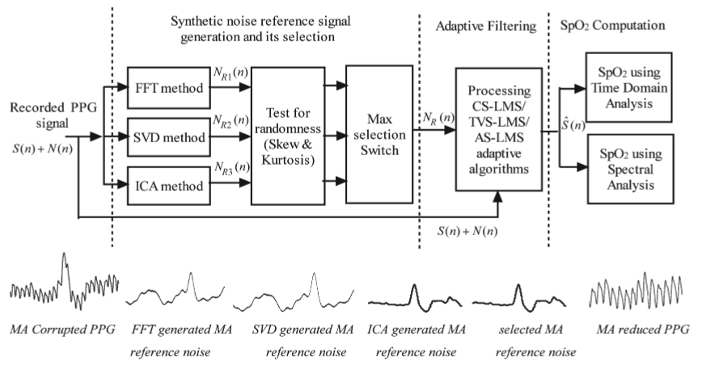
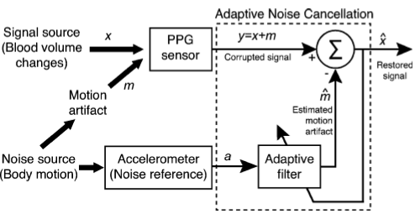
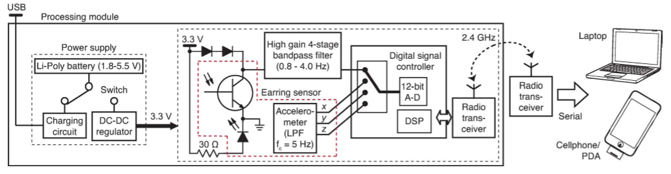
Related Approaches
Ram, M.R et al. A novel approach for artifact reduction in PPG signals based on AS-LMS adaptive filter. IEEE Instrum. Meas. 2012, 61, 1445–1457.
M. Z. Poh et al, “Motion-tolerant magnetic earring sensor and wireless earpiece for wearable photoplethysmography,” IEEE Trans Inf Technol Biomed (Epub 2010 Feb).
Notes:
FFT method: The steps involved in generating the noise reference signal using the FFT method [25] are described next.
The steps involved in generating the noise reference signal using the SVD method are described as follows.
ICA is a quite-powerful signal processing technique[17],which expresses a set of random variables as linear combination of statistically independent component variables.
The recorded PPG data were processed and analyzed using the MATLAB signal processing toolbox.
Post processing and analysis of the recordings were done using custom software written in MATLAB (The MathWorks, Inc.).
The acceleration signal was then processed with a 1024-point high-pass ﬁlter (Hamming window, cutoff frequency of 1 Hz) to remove the baseline trend.

